Slide 1
组会的意义
汇报进度与问题，集思广益，获得导师和大家的改进建议
梳理研究问题和解决思路，指导自身的科研路径规划
分享有意义的成果和想法，为大家带来科研启发
分享现有的科研工作，为大家节省读文献时间

Slide 2
Group Meeting
Zhang Yiqun
2022/09/15

Slide 3
Supervisor’s Comments
Figure out how to intuitively and clearly explain the basic idea of distance measurement (done)
Improve the clustering algorithm part, try to provide convergence proof (failed, provide more experimental results?)
Check MATLAB code, ensure there is no bug preventing the algorithm from convergence (done, converge now)
Add counterparts for journal paper (done)
Start the new anomaly detection research (in progress)
勿高估大家记忆力，记录并回顾导师建议

Slide 4
Distance Metric
日常仔细画图，积累素材，训练技能
Attribute 1
(Ordinal）
Attribute 2
(Nominal)
Attribute 1
(Ordinal)
Attribute 2
(Ordinal)
Convert nominal attributes into ordinal ones
Measure inter-category distances in the ordinal level

Slide 5
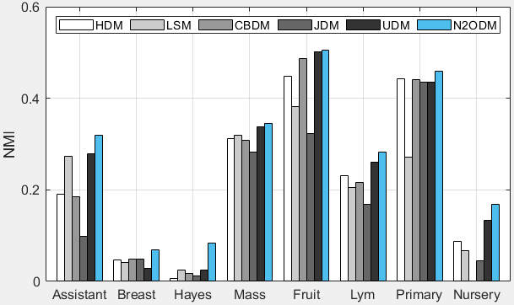
Results
形成自己的实验结果呈现程序，磨刀不误砍柴工

Slide 6
New Idea: Dynamic Distance Updating
Tighten intra-cluster distances
Loosen inter-cluster distances
Cluster 2
Cluster 1
Cluster 2
Cluster 3
Cluster 3
Cluster 1
随时记录完成任务过程中的“意外收获”

Slide 7
XXX Feature Extraction @ Anomaly Detection
Face Recognition:
ECCV’04
ICCV’05
TPAMI’06
ICB’07, ICB’07
ICIP’10, ICPR’10
ACCV’12
Deep Features:
ICIP’16 (face)
CVPR’17 (face)
ICCVW’17 (face)
Texture Classification:
ICPR’00, ECCV’00
TPAMI’02
TPAMI’07
TIP’10
TIP’14
TIP’16
ICIP’16
PR’17
TCYB’18
TCSVT’19
广读文献，论证新研究的必要性和意义

Slide 8
Survey Papers - Taxonomy
查询顶级综述文章，锁定研究问题
Inspection applications:
Electrical/electronic components
Industrial parts
Metal processing
Fabric materials
Glass and ceramic materials
Natural materials
(marble/wood grain/herb)
Inspection approaches:
Segmentation
Dimensional verification
Feature matching
Recognition
Inspection challenges:
Noise/outliers
Multi- and multi-scale anomaly
Malicious anomaly
Evolving anomaly
Labeled/training/validation data availability
[1] Automated Visual Inspection: A Survey, TPAMI, 1982, Roland T. Chin
[2] A Survey of Automated Visual Inspection, Computer Vision and Image Understanding, 1995, Anil. K. Jain
[3] Anomaly Detection: A Survey, ACM Computing Surveys, 2009, Vipin Kumar

Slide 9
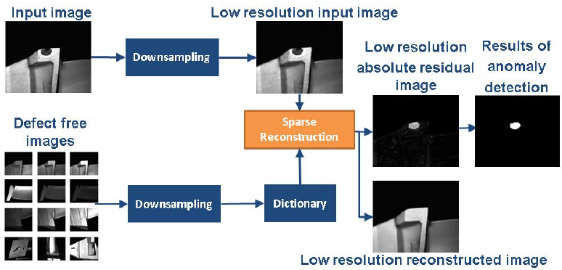


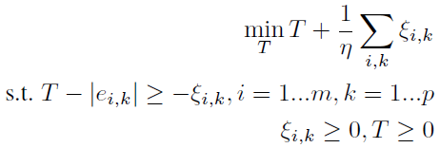
Sparse approximation-based anomaly detection
文献分享重在方法精髓和分析见解
Form dictionary
→ Sparse reconstruction
→ residual thresholding
→ learn T using 1-class SVM
Cons: many (5) parameters to determine
needs ground truth non-defect images
only feasible for “one image one anomaly”
[4] Exploiting Sparsity for Image-based Object Surface Anomaly Detection, ICASSP, 2016, Rolls-Royce Lab
[5] A Fast Sparse Reconstruction Approach for High Resolution Image-based Object Surface Anomaly Detection, ICMVA, 2017, Rolls-Royce Lab

Slide 10
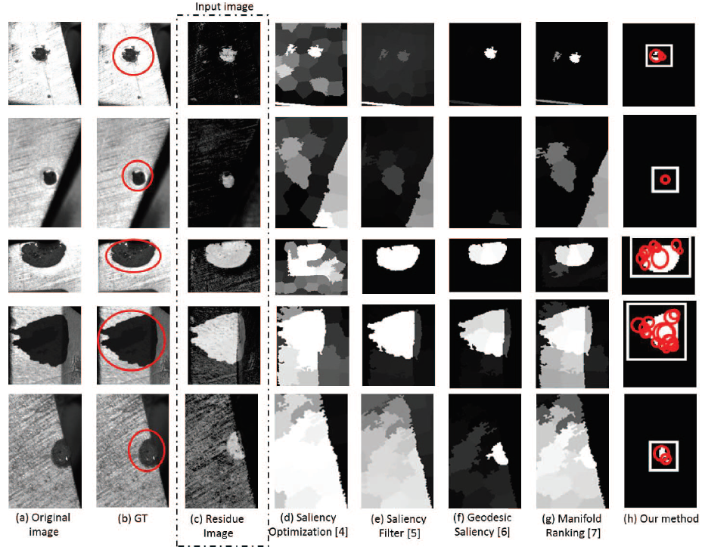
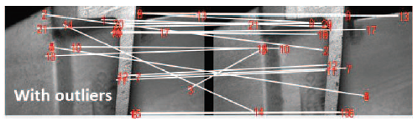
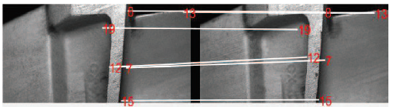
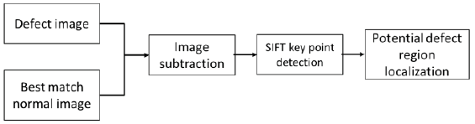
SIFT-based image matching for anomaly detection
文献分享重在方法精髓和分析见解
SIFT key point detection
→ remove outliers
→ rank the matching
[6] Anomaly Region Detection and Localization in Metal Surface Inspection, ICIP, 2016, Rolls-Royce Lab

Slide 11
Some other solutions (counterparts)
CNN-based metric learning for surface defect detection
Anomaly detection with convolutional neural networks for industrial surface inspection, CIRP, 2018
GAN-based reconstruction for surface defect detection
A Surface Defect Detection Method Based on Positive Samples, PRICAI, 2018
Segmentation-based rail surface defect detection
A Hierarchical Extractor-Based Visual Rail Surface Inspection System, IEEE Sensors Journal, 2017
概括后续非核心文献

Slide 12
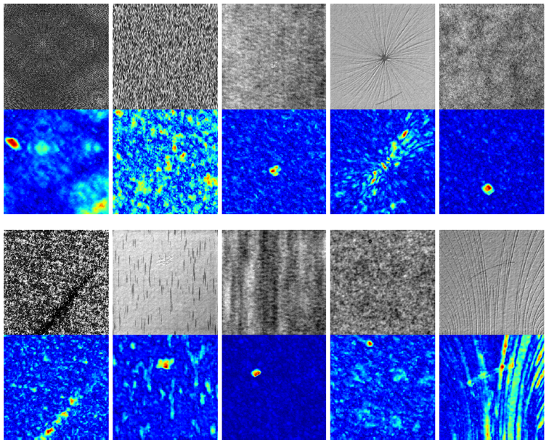
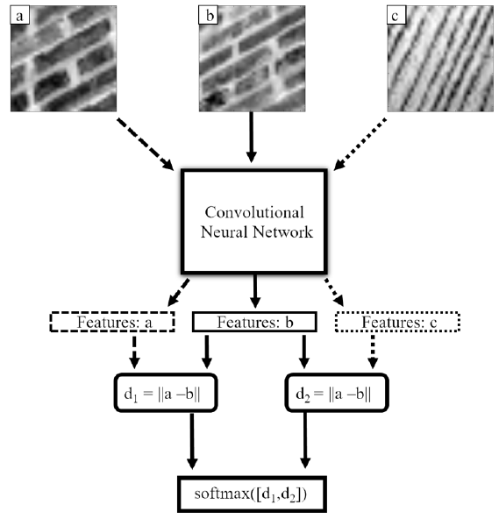
CNN-based metric learning for surface defect detection
[7] Anomaly detection with convolutional neural networks for industrial surface inspection, CIRP, 2018

Slide 13
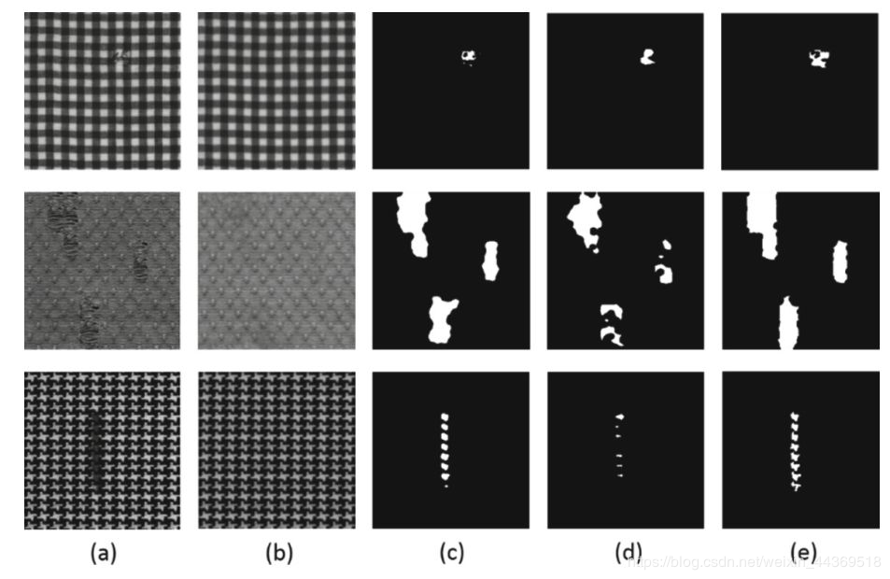
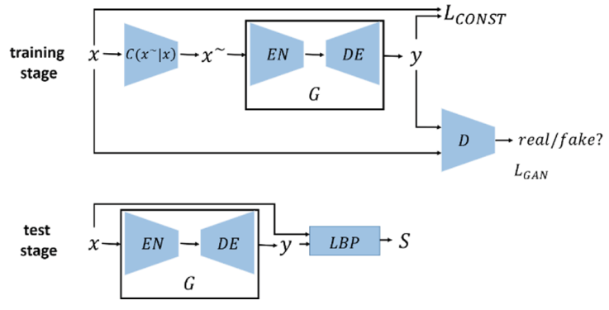
GAN-based reconstruction for surface defect detection
[8] A Surface Defect Detection Method Based on Positive Samples, PRICAI, 2018

Slide 14
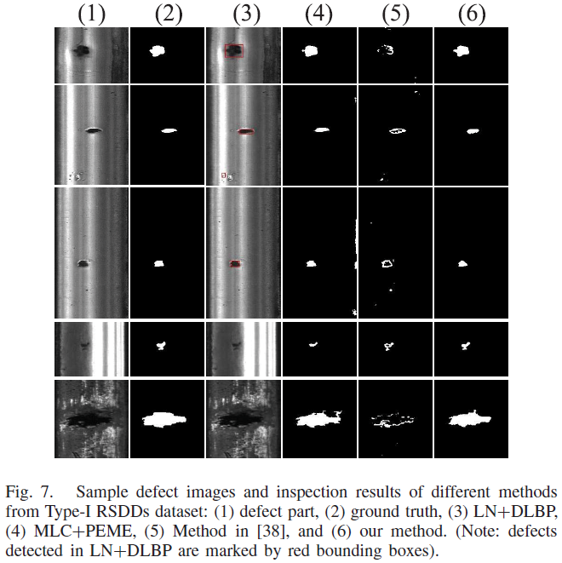
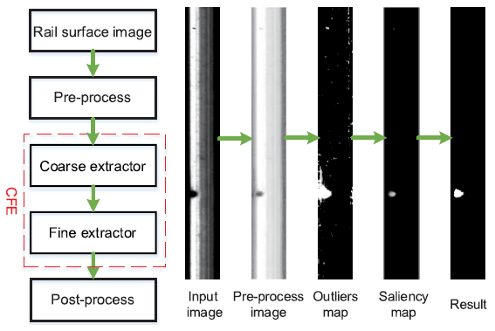
Segmentation-based rail surface defect detection
[9] A Hierarchical Extractor-Based Visual Rail Surface Inspection System, IEEE Sensors Journal, 2017

Slide 15
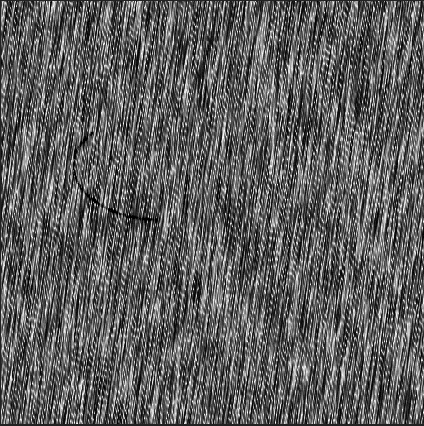


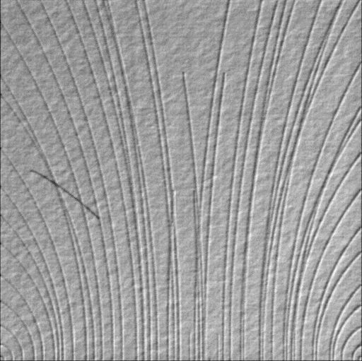
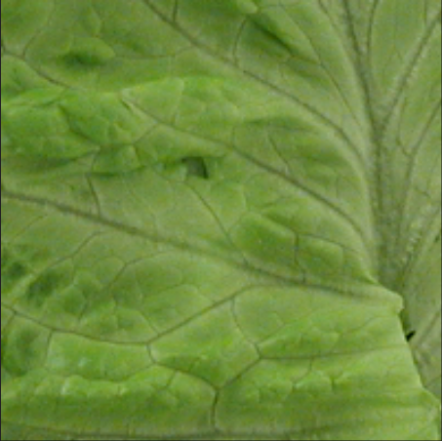
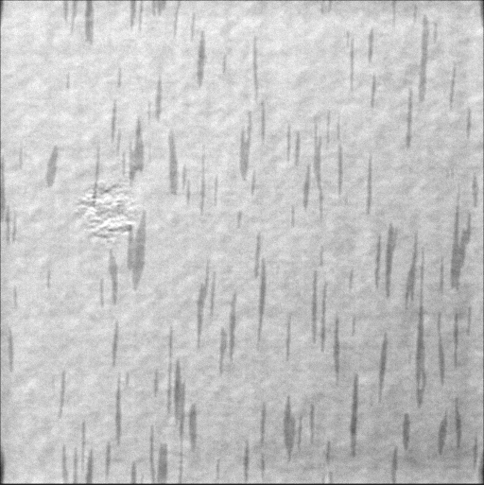
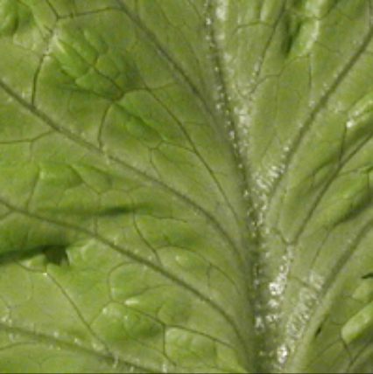
Our Focus
介绍和分析自己的 Plan A B C 让老师做选择题
A Survey?
Existing important survey papers:
- [1] TPAMI, 1982, Roland T. Chin
- [2] CVIU, 1995, Anil. K. Jain
- [3] ACM Computing Surveys, 2009, Vipin Kumar
xxx-based anomaly detection:
Plan A: Multi- and multi-scale anomaly (Hierarchical xxx)
Plan B: Evolving anomaly (Fast, inherent characteristics of xxx)
Plan C: Unavailable labeled / training / validation data (versatility and flexibility of xxx)

Slide 16
Supervisor’s Comments
Prepare a new conference paper in 1 month (new idea in page 7)
Double-check the whole paper for submission
Provide convergence evaluation (curves)
Work on Plan A in page 15 first, reproduce xxx
记录导师建议，确保科研过程高效且“收敛”

Slide 17
组会PPT结构
列出上次导师建议，简单解释是否完成、遇到的问题、解决思路
按导师建议顺序展示上次组会至今完成的工作
将形成的新idea展示出来，最好画示意图直观展示
介绍非常有启发性的文献
介绍现在到下次组会前的工作规划
会后把与导师讨论的结论列出作为接下来的工作指引

Slide 18
组会PPT结构 – DO’s and DON’Ts
列出上次导师建议，简单解释是否完成、遇到的问题、解决思路
6. 会后把与导师讨论的结论列出作为接下来的工作指引
  内容要具体、可执行、可评估。
  给出问题未解决的合理原因，后文进一步解释
  给出完成事项的解决方法，后文进一步解释
  用“继续改进”，“多思考”等词语宽泛地描述建议
  用“时间不够”，“效果不好”，“这个好难”等因素作为未解决问题的原因
  … …

Slide 19
组会PPT结构 – DO’s and DON’Ts
按导师建议顺序展示上次组会至今完成的工作
将形成的新idea展示出来，最好画示意图直观展示
  一个事项至少对应一页ppt，若简单事项可直接口头汇报
  每页ppt都应该拥有自己的“名字”
  汇报前先用简练的语言描述自己在做的事，为什么要做
  多画示意图解释自己的方法框架、流程、思路等
  将多个事项杂糅在同一张ppt内
  堆砌大量公式或技术细节而未加说明
  画图草率
  … …

Slide 20
组会PPT结构 – DO’s and DON’Ts
介绍非常有启发性的文献
  提供论文标题、发表在何处、作者姓名、机构名称——by 姬老师
  给出期刊分区标注——by 姬老师
  理清、提炼并概括论文逻辑，包括motivation、创新点、贡献——by 姬老师
  提出自己的思考、想问和想讨论的问题——by 姬老师
  直接堆砌大量公式或技术细节而未加说明
  一问三不知（不知发表在何处，不知发表日期，不知谁发表）
  文献不具启发性，为了介绍而介绍
  … …

Slide 21
组会PPT结构 – DO’s and DON’Ts
介绍现在到下次组会前的工作规划
  独立梳理思路后，主动给出自认为最好的解决方案
  还要有 Plan B, C, … 供导师和自己选择
  存在更多疑难或细节问题可跟导师单独约时间导论，不耽误组会时间——by 姬老师
  工作计划未明确或过度宽泛
  工作规划过多或过空
  … …

Slide 22
谢谢！
请老师和同学们
批评指正和补充！

